Slide 1
Controlling a Virtual Camera
Ross Ptacek
University of Alabama Birmingham

Slide 2
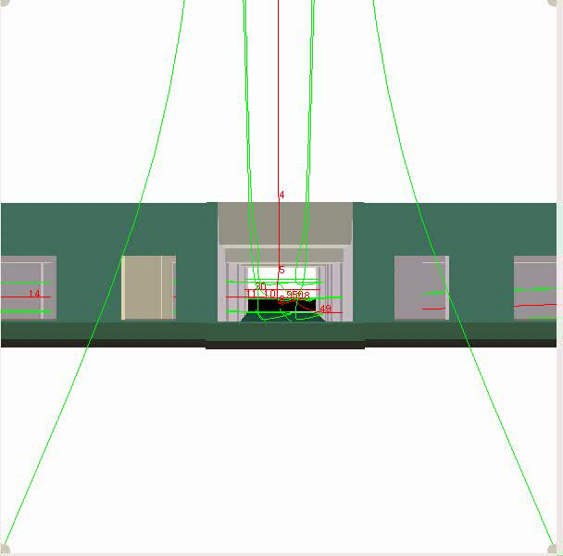
A Sample Flythrough

Slide 3
The Problems
Precompute a path through a scene
How to represent the path and scene?
How to detect problems (collisions)?
How to correct the path?

Slide 4
Path and Scene Representation
Path
  Keyframes
  Position and Orientation
  Bezier for position (B(t))
  Quaternion for orientation (Q(t))
    Numerical stability
    Robustness
Scene
  Polygonal Mesh
  Triangulated (T_{s})
    Easier to deal with
    Octree data structure

Slide 5
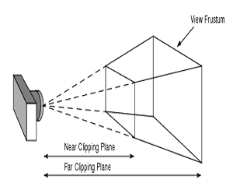
Camera Model
The path of the camera is insufficient
Rectangular Frustum view Volume
Near Clipping Plane (NCP) is important
Collisions intersect NCP

Slide 6
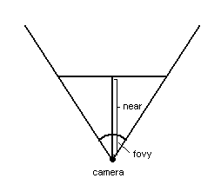
Computing NCP
Frustum Parameters
  Fovy, aspect ratio, near, far (gluPerspective)
X = near * tan (fovy / 2)
Aspect = fovy / fovx
Y = near * tan (fovx /2 )
Can calculate all corners this way
Or set with glFrustum

Slide 7
What Makes a Collision?
Intersection with NCP
NCP sweeps out a volume as the camera moves (position = B(t), ori = Q(t))
Any scene geometry that intersects this volume means collision
Need to determine what triangles are inside the volume

Slide 8
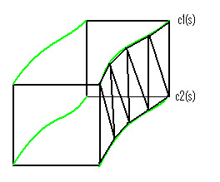
Finding the Swept Volume
Given B(t) and Q(t), find a curve for each corner of NCP, C₀(s)…C₃(s)
Johnstone and Williams ’95
  Quat. Spline -> Rotmat Spline
  Rotmat * (Corner Point) -> oriented corner point
Triangulate between C_{i}(s) and C_{(i+1)%4}(s)

Slide 9
Finding Collisions
Two Types of Collisions
  Penetrate the sides of the volume
  Fully enclosed by the volume

Slide 10
Type 1 Collisions
Triangulate between corner curves to find the outer surface of the volume (T_{p})
Sampling
  Constant interval (easy but may lose info)
  Curvature Based (harder, more accurate)
Intersect T_{p} with T_{s} to find collisions

Slide 11
Type 2 Collisions
Compute NCP at some sampling density
  Similar sampling issues as before
Triangulate each NCP and intersect with T_{s}
Add these triangles to T_{p}

Slide 12
Path correction
In general, find problem areas and push the path away from them by adding new keyframes
Identify parameter intervals w/ collisions
Find “depth” of intersection
Insert new keyframe in middle of interval pushed away from the collision

Slide 13
Octree
Too many intersection operations
Spatial Decomposition to speed up intersections
Recursively decompose space into octants
  On subdivision, send triangles to the proper octants
  If a triangle straddles 2+ octants, data duplication
Key idea for intersection: Can limit the number of scene triangles in each octant. Subdivide when n triangles have been inserted
Careful choice of n as duplication diminishes speed ups

Slide 14
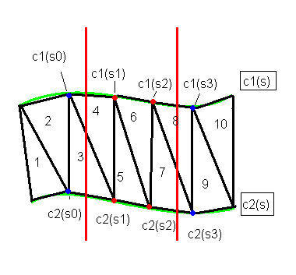
Find Parameter Interval
Assign parameter value to each element of T_{p}
Sort T_{p} by parameter value & intersect in sorted order
When an intersection is found, record the parameter value (s₁) and the value of the previous triangle(s₀)
Use binary search between s₁ and s₀ to find the exact parameter where the first intersection occurs (s_{i}).
Continue inserting triangles until there is no intersection. Record the parameter value (s₃) and the previous (s₂) and use binary search between them to find s_{f}.

Slide 15
Determining the New Keyframe
Need both Position and Orientation
Orientation first
  Find s_{mid} = (s_{f} – s_{i})/2
  s is not in same parameter as B(t)!
  Same number of knots
  Use linear interpolation to find a parameter, t_{mid} for B(t) and Q(t)
Use Q(t_{mid}) for the orientation

Slide 16
New Position
Start with B(t_{mid}) and move away from where the intersections are
Compute NCP at s=s_{mid}
Intersect line segments from the middle of the NCP to each corner
  If there is an intersection, consider that corner “bad”, otherwise consider it “good”
Intersect the four edges of the NCP with T_{s} and record parameter values along the edges where intersections occur

Slide 17
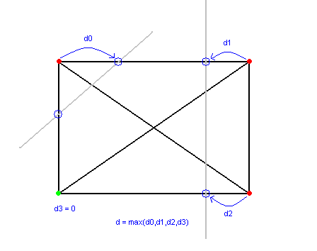
New Position (cont.)
For each “bad” corner, find the intersections closest to it on each connected edge. Choose the max of these as the corner depth
Take the max corner depth of all bad corners as the overall depth, d

Slide 18
New Position (cont.)
Take vectors from the center to each “good” corner
Average these vectors and normalize the result (V)
Scale this vector (V) by f
New position = B(t_{mid}) + d*V
Repeat until the NCP is not intersecting
Continue insersecting triangles ordered by parameter value but start with s_{i} (rescan interval)

Slide 19
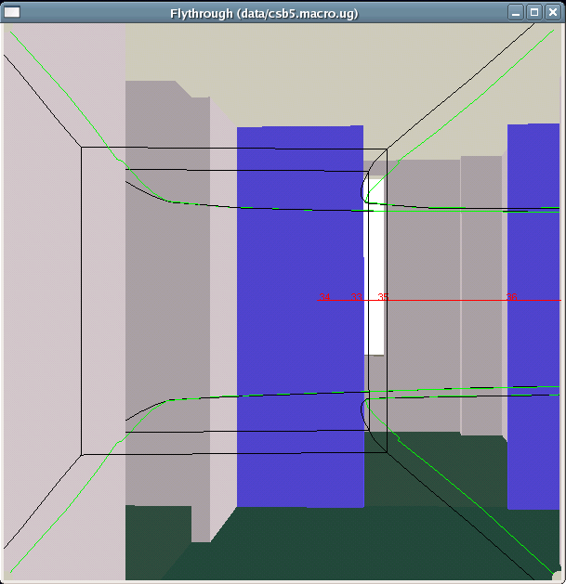
Results
Black curves: original corner curves
Green curves: corrected corner curves
Black box: NCP at endpoints of intersection interval
Red line: B(t)

Slide 20
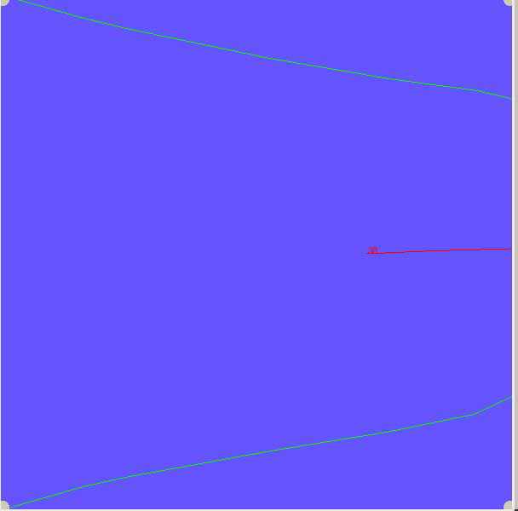
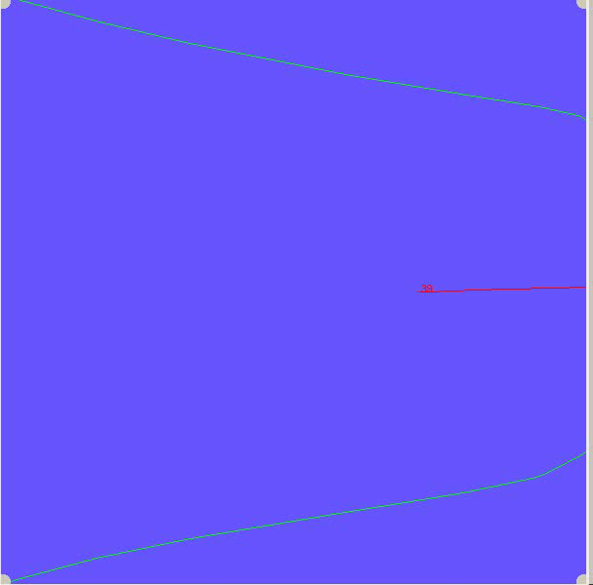
More Results

Slide 21
Conclusion
Smooth natural path
Avoids collisions
Fairly fast. Worse intersections mean more computation needed to correct

Slide 22
Future Work
BSP tree rather than Octree
Different measure of intersection depths
Orientation constraints
Some key frame configurations make collision avoidance impossible

Slide 23
Thanks
UAB Department of Computer Science
Dr. Johnstone

